Slide 1

23ECE381 Open Laboratory I
DIGITAL LOCKING SYSTEM WITH UNAUTHORIZED ACCESS ALERT
Presented By :23ECE381C10
Group Members:
Chittesh S(CB.EN.U4ECE23212)
Sricharan R P(CB.EN.U4ECE23246)
Sujith Krishna P G(CB.EN.U4ECE23249)

Slide 2

OVERVIEW
Objectives
Block Diagram
Literature Survey
References

Slide 3
OBJECTIVES
To develop a digital locking system using only digital logic circuits
To integrate a keypad for password entry
To make the saved password customizable
To provide visual and audio indication for password verification
To test logic sequence, reset, and correct code detection mechanisms.

Slide 4
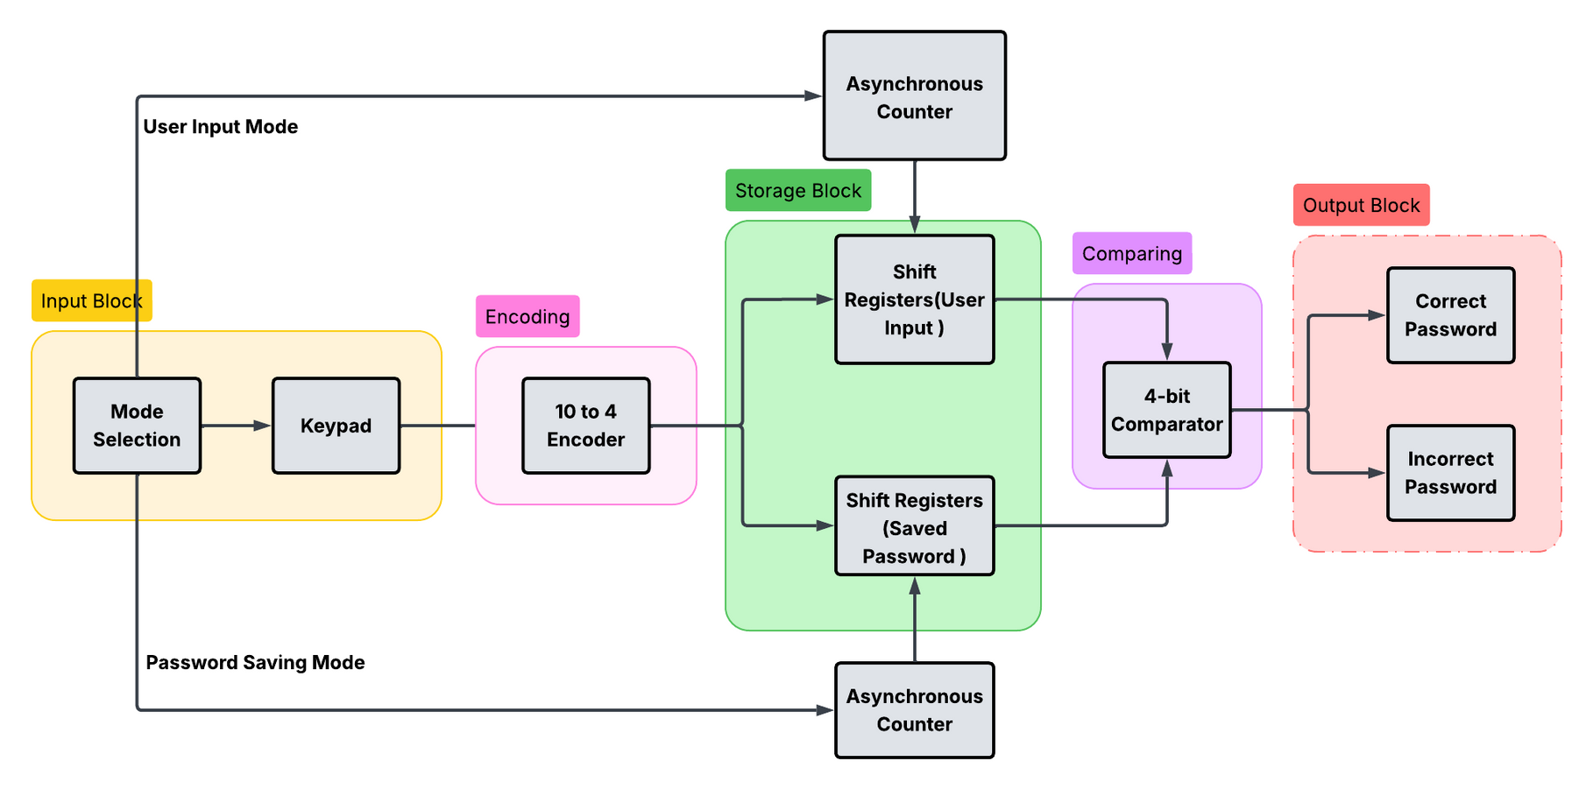
BLOCK DIAGRAM

Slide 5
LITERATURE SURVEY
Tile of the Paper | Source | Source | Inferences from the paper
Digital Design of a Digital Combination Lock | Authors | Published in | FSM-based 4-digit lock using keypad, multiplexer, timers, and controller. Verifies auto-relock and incorrect-sequence detection—relevant to use of CD4017 counters and reset logic.
Digital Design of a Digital Combination Lock | Arnab Pramanik | Int. Journal of Engineering Research and Applied Science (IJERAS), Vol. 1, Issue 1, 2014 | FSM-based 4-digit lock using keypad, multiplexer, timers, and controller. Verifies auto-relock and incorrect-sequence detection—relevant to use of CD4017 counters and reset logic.

Slide 6
Tile of the Paper | Source | Source | Inferences from the paper
Advance Security System | Authors | Published in | Combines keypad and RFID input; incorporates reset after 3 wrong attempts. Buzzer, LEDs, and sound alerts add multi-layered feedback—reset logic and sequential attempts matching discrete 4017-based lock.
Advance Security System | Sangeeta Kurundkar, Gaurav Bhole, Shreyash Bele, Bhagyesh Bhoge, Aditya Bhosale | 2023 IEEE 8th Int. Conf. for Convergence in Technology (I2CT), Pune, India. doi: 10.1109/I2CT57861.2023.10126415 | Combines keypad and RFID input; incorporates reset after 3 wrong attempts. Buzzer, LEDs, and sound alerts add multi-layered feedback—reset logic and sequential attempts matching discrete 4017-based lock.

Slide 7
Tile of the Paper | Source | Source | Inferences from the paper
Design and Implementation of an IoT-based Smart Door Lock System | Authors | Published in | Uses keypad, fingerprint, and voice as 3-tier authentication. Reinforces the concept of combining multiple input validation paths and FSM-style control logic—can be also done using combinational and sequential logic blocks in hardware.
Design and Implementation of an IoT-based Smart Door Lock System | Abdullahi Ahmed, Jama Mohamed , Mowlid Abdi, Said Abdulkadir | 2023 2nd International Conference on Multidisciplinary Engineering and Applied Science (ICMEAS) IEEE | DOI: 10.1109/ICMEAS58693.2023.10379324 | Uses keypad, fingerprint, and voice as 3-tier authentication. Reinforces the concept of combining multiple input validation paths and FSM-style control logic—can be also done using combinational and sequential logic blocks in hardware.

Slide 8
Tile of the Paper | Source | Source | Inferences from the paper
Development of a Programmable Electronic Digital Code Lock System | Authors | Published in | Describes keypad interfaced to microcontroller and comparator logic, reset after 4 wrong entries, with programmable code storage. Suggests programmable flexibility in logic which you can implement with switches and logic gates.
Development of a Programmable Electronic Digital Code Lock System | Oke Alice O., Adigun Adebisi A., Falohun Adeleye S., and Alamu F. O. | Int. Journal of Computer and Information Technology (IJCIT), Vol. 2, Issue 1, Jan. 2013 | Describes keypad interfaced to microcontroller and comparator logic, reset after 4 wrong entries, with programmable code storage. Suggests programmable flexibility in logic which you can implement with switches and logic gates.

Slide 9
Tile of the Paper | Source | Source | Inferences from the paper
Smart Door Locking System | Authors | Published in | Combines RFID and OTP. Discusses cloud alerts, timed access, and alert buzzer logic. Although IoT-based, the layered feedback and OTP/timeout behavior can be mapped into sequential logic blocks for error timeout or unlock timeout design.
Smart Door Locking System | Aswini D, Rohindh R, Manoj Ragavendhara KS, Mridula C S | 2021 Int. Conf. on Advancements in Electrical, Electronics, Communication, Computing and Automation (ICAECA), doi: 10.1109/ICAECA52838.2021.9675590 | Combines RFID and OTP. Discusses cloud alerts, timed access, and alert buzzer logic. Although IoT-based, the layered feedback and OTP/timeout behavior can be mapped into sequential logic blocks for error timeout or unlock timeout design.

Slide 10
REFERENCES
S. Kurundkar, B. Bhoge, G. Bhole, S. Bele, and A. Bhosale, “Advance security system,” in Proc. 2023 IEEE 8th Int. Conf. for Convergence in Technology (I2CT), Pune, India, Apr. 2023, pp. 1–4. doi: 10.1109/I2CT57861.2023.10126415
A. Ahmed, J. Mohamed, M. Abdi, S. Abdulkadir, S. A. Ali, and S. A. Kahie, “Design and Implementation of an IoT based Smart Door Lock System,” in Proc. 2023 2nd Int. Conf. on Multidisciplinary Engineering and Applied Science (ICMEAS), Mogadishu, Somalia, 2023, pp. 1–5. doi: 10.1109/ICMEAS58693.2023.10379324
A. Oke, A. A. Adigun, A. S. Falohun, and F. O. Alamu, “Development of a Programmable Electronic Digital Code Lock System,” Int. J. Computer and Information Technology, vol. 2, no. 1, pp. 127–130, Jan. 2013. [Online]. Available: https://www.researchgate.net/publication/297637448
A. Pramanik, “Digital Design of a Digital Combination Lock,” Int. J. Eng. Res. Appl. Sci. (IJERAS), vol. 1, no. 1, pp. 18–23, 2014.
D. Aswini, R. Rohindh, C. S. Mridula, and K. S. Manoj Ragavendhara, “Smart Door Locking System,” in Proc. 2021 Int. Conf. on Advancements in Electrical, Electronics, Communication, Computing and Automation (ICAECA), Coimbatore, India, 2021, pp. 1–5. doi: 10.1109/ICAECA52838.2021.9675590

Slide 11


THANK YOU

